Slide 1
A Neural-Network-Based Formant Tracker Trained on Unlabeled Data
Jason Lilley and H. Timothy Bunnell
Nemours Biomedical Research
Wilmington, DE, USA

Slide 2
The Problem: Formant measurements for large corpora
Formant measurement is often a vital step in phonetic analysis
Manual formant measurement can be difficult, tedious
Popular off-the shelf, LPC-based formant trackers are prone to large errors, at least with default settings (Deng et al. 2006; Schiel & Zitzelberger, 2018; Dissen et al. 2019)
Perhaps better measurements can be obtained by tuning tracker settings to individual speakers
But this would be quite tedious for a large corpus of many speakers

Slide 3
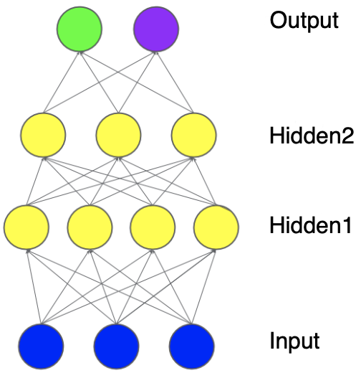
Deep Neural Networks (DNNs)
Consist of layers of units (circles)
Units compute a nonlinear function of the weighted sum of its inputs: y = f(WX + B)
Outputs are compared to target reference values to compute a loss (error)
Loss is used to adjust model weights in a process called backpropagation (red arrows)
Special types of neural networks:
Convolutional neural network (CNN): Used for image input (e.g. spectrograms)
Recurrent neural network (RNN): Used for sequences (e.g. sound waves)
LSTM (Long Short-Term Memory): one type of RNN
Reference
Values

Slide 4
“DeepFormants”: a DNN Formant Tracker
Dissen et al. (2016, 2019) trained a neural network (“DeepFormants”) to estimate formant frequencies F1-F3
Trained on the hand-measured F1-F3 frequencies of a 538-file subset (Deng et al. 2004) of the 6300-file TIMIT corpus (Garofolo et al. 1993)
346 files used for training; 192 withheld for testing
Two models: one LSTM; one a combination RNN-CNN (“DF-RCNN”)
Showed results generally superior to other methods on the TIMIT dataset (Praat, WaveSurfer, MSR, KARMA; see also Schiel & Zitzelberger, 2018)

Slide 5
“DeepFormants” uses supervised training
TIMIT-trained “DeepFormants” models show higher errors on other corpora, e.g. Hillenbrand and Clopper datasets (Dissen et al. 2019)
They demonstrate improved performance by adapting their models to the new datasets
But the adaptation process also requires prior formant measurements from the new corpora
Bottom line: The DeepFormants approach requires prior formant measurements from any corpus it is trained on or adapted to
Can we train a DNN formant tracker without prior measurements? YES!

Slide 6
Our Solution: “FormantNet”
Unsupervised training: Requires no prior formant measurements
Model input: 257-point smoothed spectral envelope computed from a 32-msec window of speech collected every 5 msec
Model output: Formant frequencies, bandwidths, and amplitudes for all formants in the input frequency range (0-8 KHz)
A model of the entire vocal-tract signal
Formant parameters used to calculate a model spectral envelope
Loss is calculated as difference between input and model envelopes
Loss is back-propagated to amend the model weights

Slide 7
Reference Formant features
DeepFormants:
Derived input features fed to neural network
Neural network predicts formant parameters
Predicted formant parameters compared to hand-labeled parameters to compute loss
Decoding Logic
Predicted Formant features
Predicted
Formant features
FormantNet:
Input spectrum fed to neural network
Fixed logic maps predicted Formant features to predicted spectrum
Predicted spectrum compared to input spectrum to compute loss
Neural Network
Neural Network
350 features (LPC + DCT) derived from input waveform

Slide 8
Autoencoder:
Weights are trained in both encoding and decoding layers
Bottleneck features are learned as a compact set
Post Hoc discovery needed to interpret learned Bottleneck features
Decoding Layers
Decoding Logic
Bottleneck features
Predicted
Formant features
FormantNet:
Weights are trained in encoding layer only
Formant features are learned as a compact set
Fixed logic mapping Formant features to spectrum makes features immediately interpretable
Encoding Layers
Encoding Layers

Slide 9
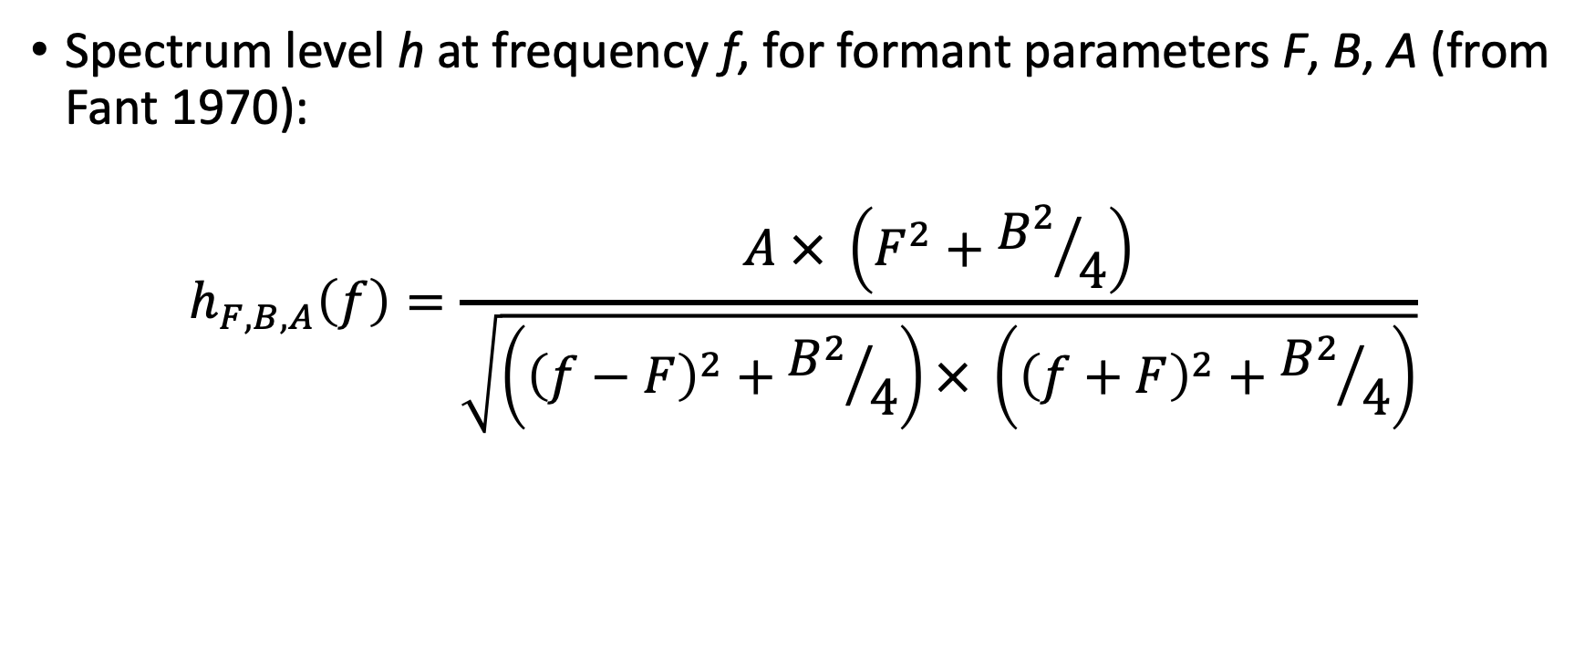
Approach
Spectrum level h at frequency f, for formant parameters F, B, A (from Fant 1970):
$$h_{F,B,A}\left(f\right)=\frac{A × \left(F^{2}+{B^{2}}/4\right)}{\sqrt{\left({\left(f−F\right)}^{2}+{B^{2}}/4\right)× \left({\left(f+F\right)}^{2}+{B^{2}}/4\right)}}$$

Slide 10
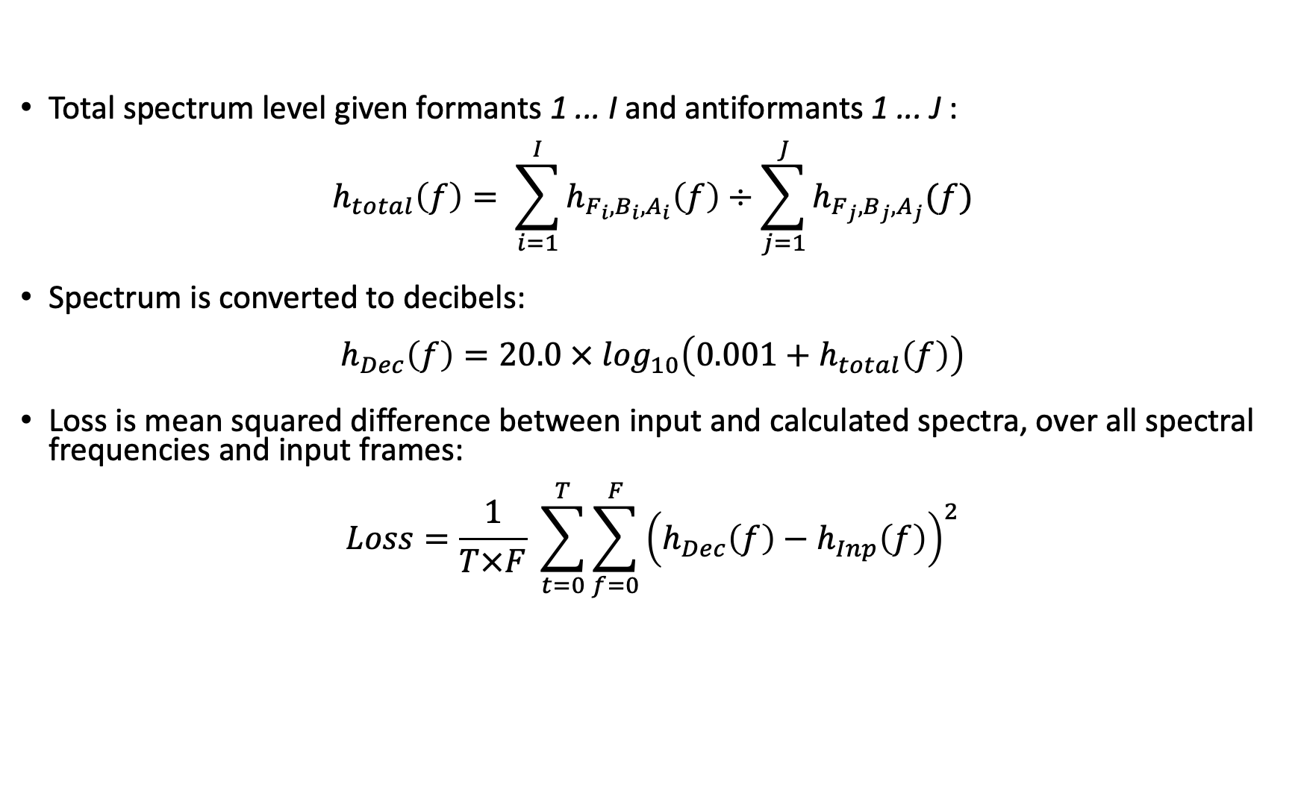
Approach (continued)
Total spectrum level given formants 1 ... I and antiformants 1 ... J :
$$h_{total}\left(f\right)= \sum_{i=1}^{I}{h_{F_{i},B_{i},A_{i}}\left(f\right)÷\sum_{j=1}^{J}{h_{F_{j},B_{j},A_{j}}(f)}}$$
Spectrum is converted to decibels:
$$h_{Dec}\left(f\right)=20.0 × \log_{10}\left(0.001+h_{total}\left(f\right)\right)$$
Loss is mean squared difference between input and calculated spectra, over all spectral frequencies and input frames:
$$Loss=\frac{1}{T×F} \sum_{t=0}^{T}{\sum_{f=0}^{F}{{\left(h_{Dec}\left(f\right)−h_{Inp}\left(f\right)\right)}^{2}}}$$

Slide 11
Approach (continued)
FormantNet requires that the user choose the number of formants and antiformants to model, prior to model training
Should be based on the average number expected within the entire input frequency range (e.g. 0-8000 Hz), for the talker population in the corpus
Too few: The model spreads out the formants to cover the frequency range
Too many: The model will insert extra formants where they don’t belong
For TIMIT (0-8 KHz): best models had 6 formants, 1 antiformant
Generates a model of the entire vocal-tract signal

Slide 12
Implementation Details
“Train” portion of the TIMIT dataset split in two:
4140-file training set
480-file validation set
Hand-labeled formant measurements not used for training
Trained for max. 200 epochs; model w/best validation loss chosen
Evaluated on the 192-file hand-labeled “test” set
Different architectures evaluated:
Convolutional neural network (CNN)
LSTM, a type of Recurrent neural network (RNN)
Bidirectional LSTM (BLSTM)

Slide 13
InterSpeech 2021 results: Comparison of model architectures
MAE, all segments
Model | Mean | F1 | F2 | F3
LSTM1 | 114 | 100 | 115 | 126
BLSTM1 | 114 | 102 | 115 | 126
LSTM3 | 131 | 102 | 146 | 146
CNN3 | 129 | 105 | 117 | 165
MAE, vowels
Model | Mean | F1 | F2 | F3
LSTM1 | 76 | 64 | 75 | 90
BLSTM1 | 77 | 65 | 77 | 90
LSTM3 | 81 | 65 | 81 | 96
CNN3 | 86 | 65 | 81 | 111
LSTM1: 1 LSTM layer (512 units) + 1 Dense output layer (20 units)
Performed just as well as larger LSTM, BLSTM, and CNN models

Slide 14
IS2021 results: Comparison with other trackers
RMSE, all segments
Model | Mean | F1 | F2 | F3
LSTM1 | 173 | 143 | 177 | 195
Deep Formants | 163 | 118 | 169 | 204
DF-RCNN | 173 | 127 | 180 | 213
KARMA | 220 | 114 | 226 | 320
MAE, vowels
Model | Mean | F1 | F2 | F3
LSTM1 | 76 | 64 | 75 | 90
Deep Formants | 82 | 54 | 81 | 112
DF-RCNN | 78 | 53 | 72 | 108
MSR 2006 | 98 | 64 | 105 | 125
WaveSurfer | 106 | 70 | 94 | 154
Praat | 209 | 130 | 230 | 267

Slide 15
Example input vs. model spectra: /u/

Slide 16
Example spectrogram
Red: Hand-measured frequencies (F1-F3)
Blue: Model frequencies (F1-F4)

Slide 17
New advances
Delta-frequency (△f) loss
Source function modeling

Slide 18
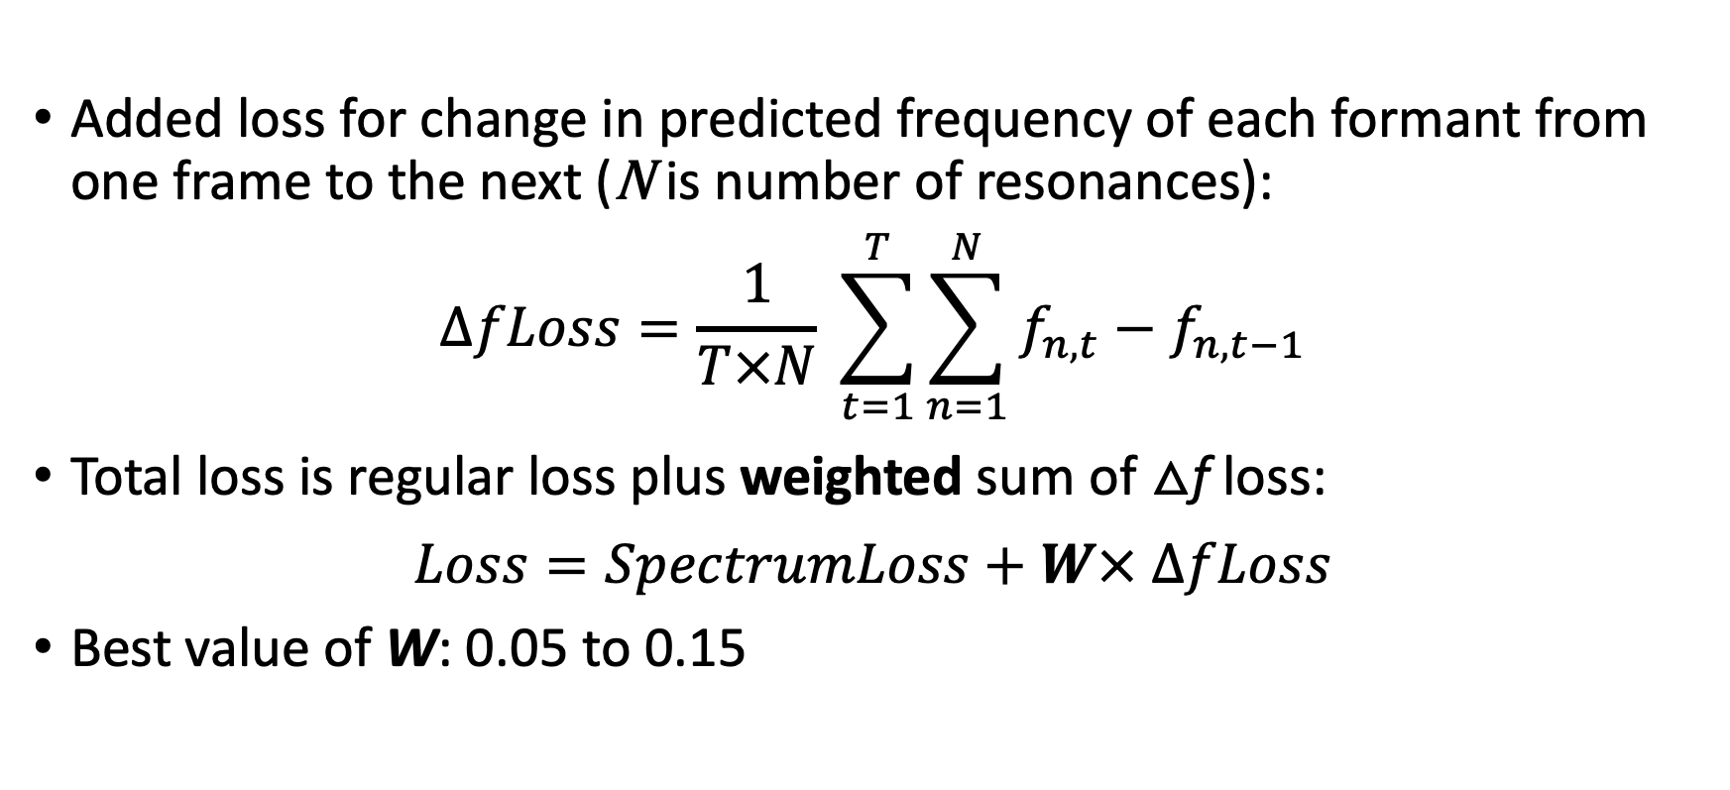
Delta-frequency (△f) Loss
Added loss for change in predicted frequency of each formant from one frame to the next (N is number of resonances):
$$ΔfLoss=\frac{1}{T×N} \sum_{t=1}^{T}{\sum_{n=1}^{N}{f_{n,t}−f_{n,t−1}}}$$
Total loss is regular loss plus weighted sum of △f loss:
$$Loss=SpectrumLoss+W× ΔfLoss$$
Best value of W: 0.05 to 0.15

Slide 19
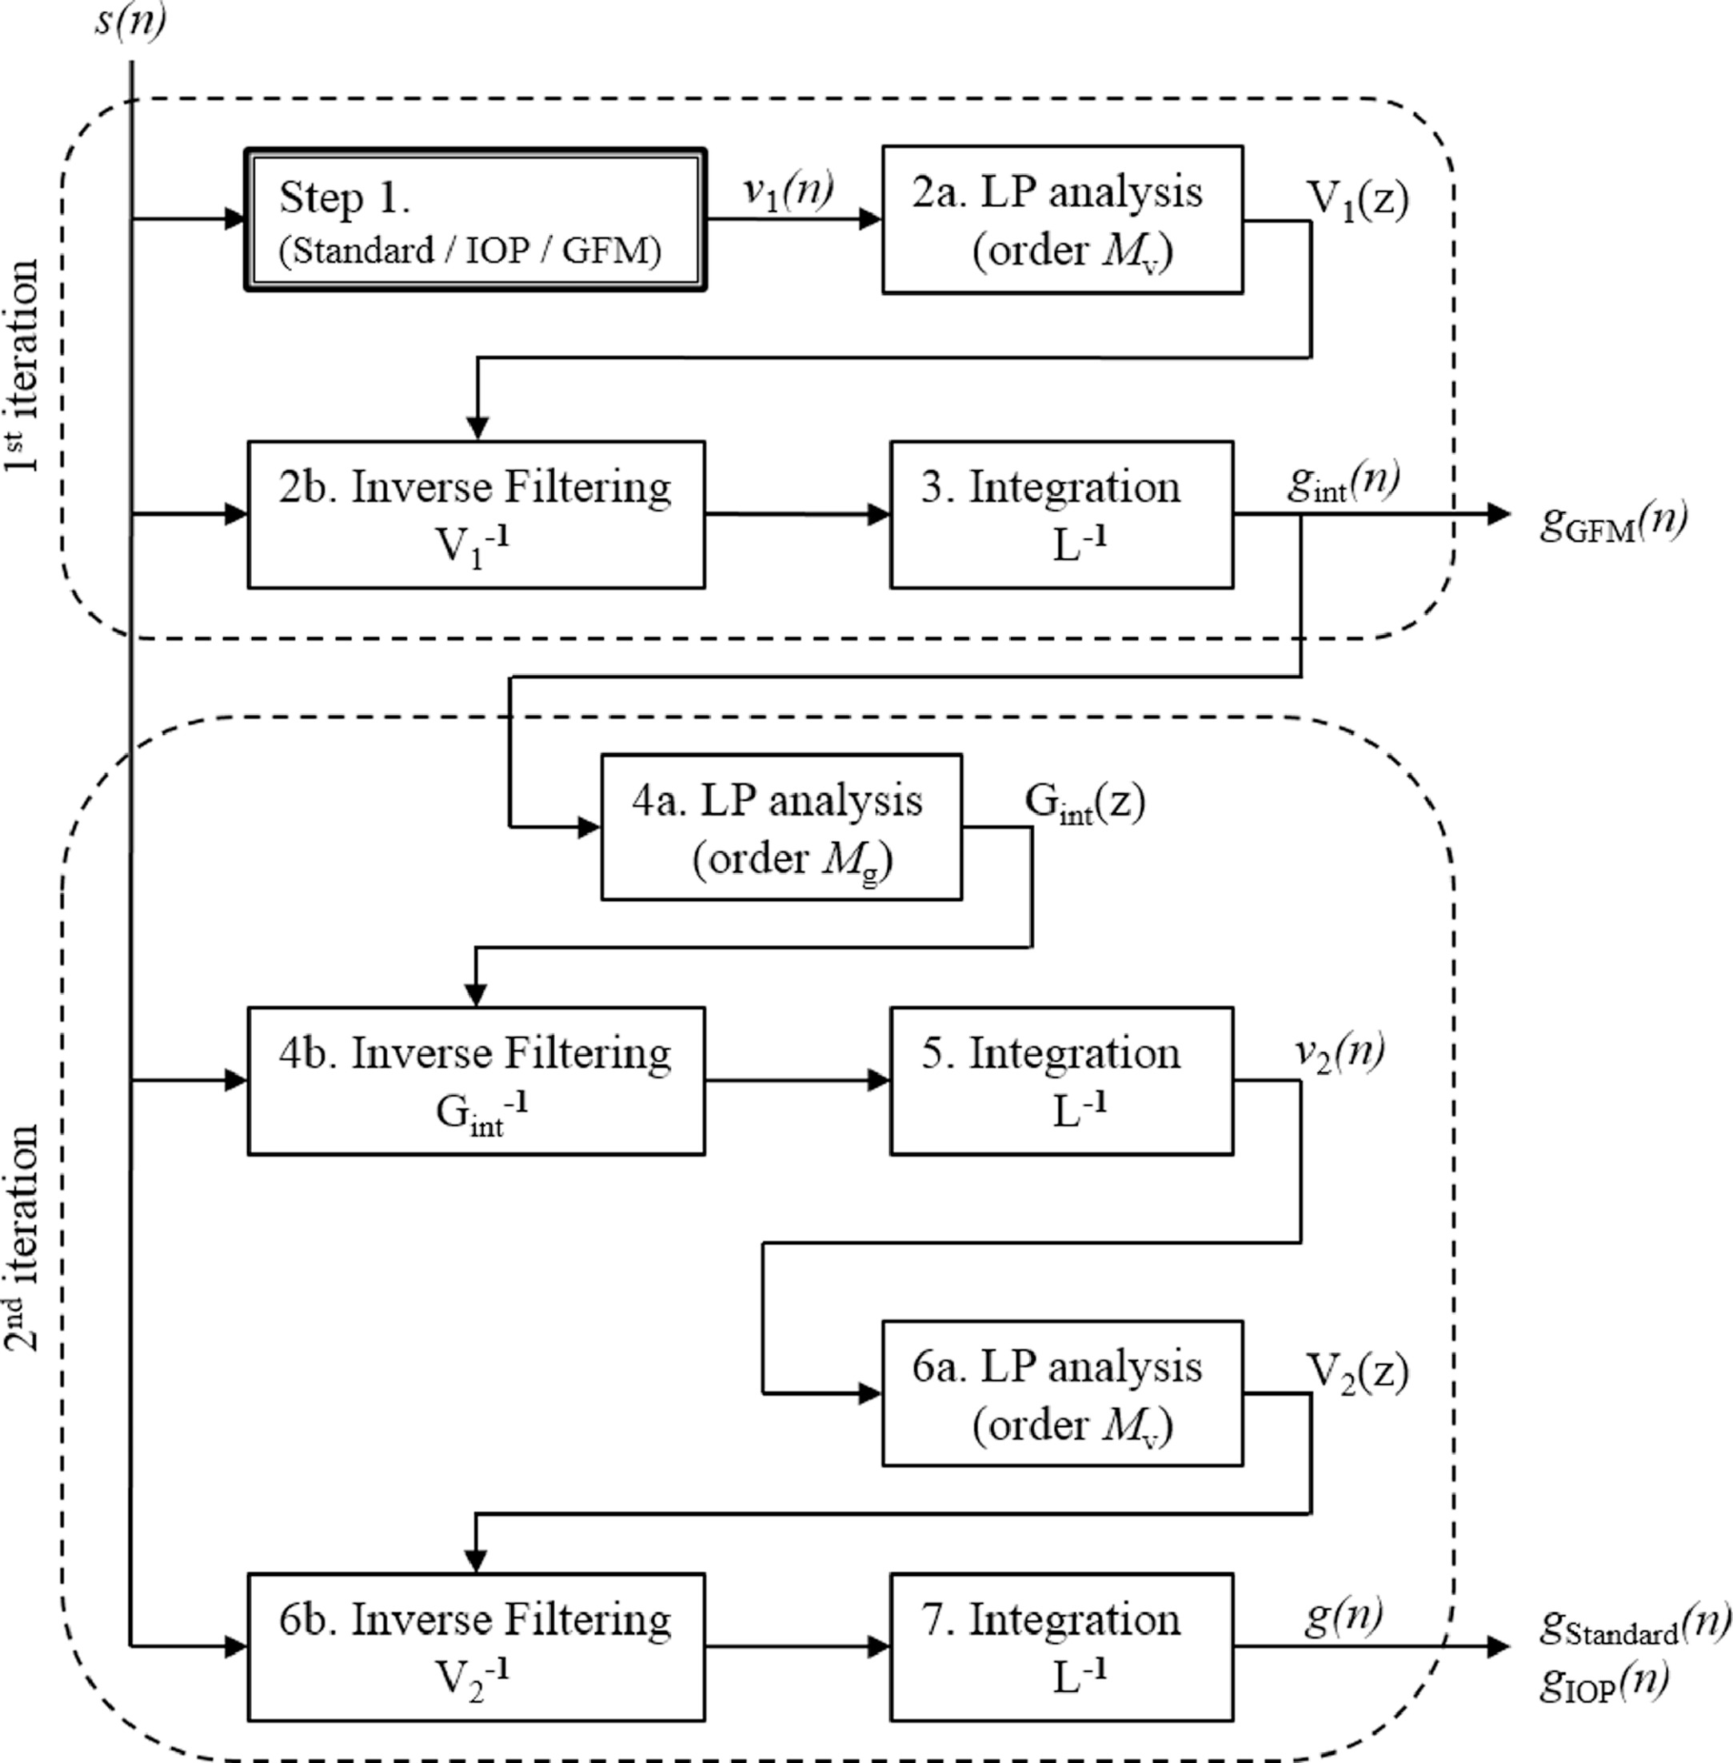
Source function modeling
Iterative Adaptive Inverse Filtering (IAIF) (Alku 1991, 1992): complex algorithm to separate and remove the glottal excitation function from the vocal tract transfer function
Is the IAIF interfering with measurement of F1?
We compared IAIF to 2 source modeling alternatives:
Pre-emphasis (S_{t} = s_{t} – 0.98 s_{t-1})
No source model
(from Mokhtari et al. 2018)

Slide 20
Summary: △f Loss and Source Modeling
MAE, all segments
Source | W | Mean | F1 | F2 | F3
IAIF | 0 | 114 | 100 | 115 | 126
PE | 0 | 118 | 92 | 123 | 140
None | 0 | 115 | 94 | 121 | 130
IAIF | .05 | 105 | 97 | 99 | 118
PE | .15 | 98 | 88 | 98 | 109
None | .10 | 99 | 89 | 98 | 111
MAE, vowels
Source | W | Mean | F1 | F2 | F3
IAIF | 0 | 76 | 64 | 75 | 90
PE | 0 | 76 | 62 | 76 | 94
None | 0 | 76 | 61 | 80 | 92
IAIF | .05 | 75 | 62 | 72 | 92
PE | .15 | 71 | 58 | 70 | 86
None | .10 | 70 | 51 | 72 | 87

Slide 21
Comparison with other trackers
RMSE, all segments
Model | Mean | F1 | F2 | F3
FNet PE15 | 150 | 125 | 146 | 174
FNet NS10 | 152 | 133 | 144 | 176
LSTM1 | 173 | 143 | 177 | 195
Deep Formants | 163 | 118 | 169 | 204
DF-RCNN | 173 | 127 | 180 | 213
KARMA | 220 | 114 | 226 | 320
MAE, vowels
Model | Mean | F1 | F2 | F3
FNet PE15 | 71 | 58 | 70 | 86
FNet NS10 | 70 | 51 | 72 | 87
LSTM1 | 76 | 64 | 75 | 90
Deep Formants | 82 | 54 | 81 | 112
DF-RCNN | 78 | 53 | 72 | 108
MSR | 98 | 64 | 105 | 125
WaveSurfer | 106 | 70 | 94 | 154
Praat | 209 | 130 | 230 | 267

Slide 22
Further experiments
Effect of training set size
Testing the models on a different corpus

Slide 23
Effect of Training Size
Reduction by # of files/speaker:
From 10 files/speaker (4140 total)
To 2 files/speaker (828 total)
Reduction by # of speakers
From 414 speakers (4140 files)
To 69 speakers (690 files)
Validation set also reduced proportionally

Slide 24
Effect of Training Size
Reduction by # of files/speaker:
From 10 files/speaker (4140 total)
To 2 files/speaker (828 total)
Reduction by # of speakers
From 414 speakers (4140 files)
To 69 speakers (690 files)
Validation set also reduced proportionally

Slide 25
Testing and Adapting the TIMIT model on the Hillenbrand corpus
MAE, vowels
Model | Mean | F1 | F2 | F3
Hillenbrand | 237 | 47 | 291 | 376
TIMIT NS10 | 109 | 33 | 133 | 161
TIMIT NS10 adapted | 73 | 29 | 85 | 107
TIMIT PE15 | 123 | 43 | 140 | 188
TIMIT PE15 adapted | 59 | 47 | 48 | 84
DeepFormants | 143 | 71 | 160 | 131
DeepFormants adapted | 83 | 36 | 100 | 116
Hillenbrand dataset:
1668 single-syllable words
Only vowel formants measured
Mix of adults and 10-12yo kids
Small dataset: adaptation helps!
With a large enough dataset, it’s probably better to train from scratch

Slide 26
Conclusions
“FormantNet” algorithm can be used to train a tracker on a corpus without prior hand-obtained formant measures for training
Works best on a reasonably large corpus
Lower error than popular LPC-based trackers and supervised DNNs
Source modeling is a continued avenue of research
Produces a model of the entire vocal-tract signal: Bandwidths, amplitudes, and higher formants
Useful for e.g. formant speech synthesis
Available now: github.com/NemoursResearch/FormantTracking
Soon github.com/NemoursResearch/FormantNet

Slide 27
Example spectrogram
Red: Hand-measured frequencies (F1-F3)
Blue: Model frequencies (F1-F4)

Slide 28
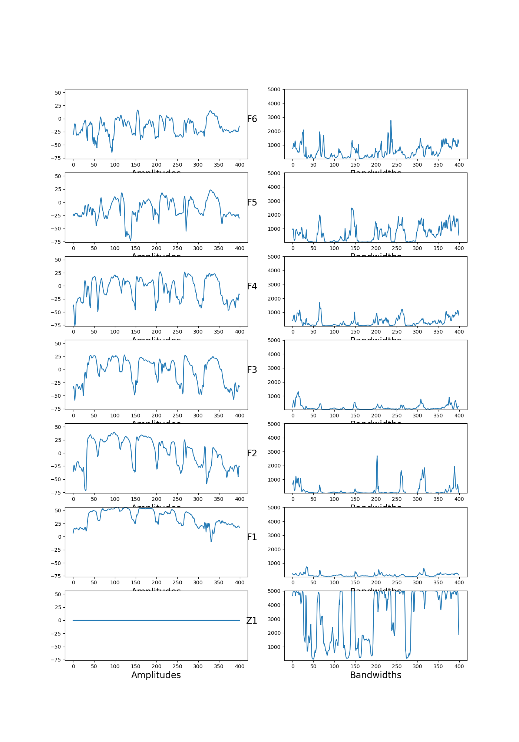
Amplitudes and Bandwidths

Slide 29
Cited References
P. Alku, “Glottal wave analysis with pitch synchronous iterative adaptive filtering,” Speech Communication, vol. 19, pp. 459–476, 1992.
P. Boersma and D. Weenink, “Praat, a system for doing phonetics by computer,” Glot International, vol. 5, no. 9/10, pp. 341-345, 2002.
C. G. Clopper and T. N. Tamati, “Effects of local lexical competition and regional dialect on vowel production,” Journal of the Acoustical Society of America, vol. 136, no. 1, pp. 1-4, 2014.
L. Deng, L. J. Lee, H. Attias, and A. Acero, “A structured speech model with continuous hidden dynamics and prediction-residual training for tracking vocal tract resonances,” in Proceedings of ICASSP 2004—IEEE International Conference on Acoustics, Speech and Signal Processing, vol. 1, pp. I-557, 2004.
L. Deng, X. Cui, R. Pruvenok, Y. Chen, S. Momen, and A. Alwan, “A database of vocal tract resonance trajectories for research in speech processing,” in Proceedings of ICASSP 2006—IEEE International Conference on Acoustics, Speech and Signal Processing, vol. 1, pp. I-I, 2006.
Y. Dissen, J. Goldberger, and J. Keshet, “Formant estimation and tracking: A deep learning approach,” Journal of the Acoustical Society of America, vol. 145, no. 2, pp. 642-653, Feb. 2019.
G. Fant, Acoustic Theory of Speech Production. The Hague: Mouton, 1970.
J. S. Garofolo, L. F. Lamel, W. M. Fisher, J. G. Fiscus, D. S. Pallett, N. L. Dahlgren, and V. Zue, The DARPA TIMIT acoustic-phonetic continuous speech corpus. Linguistic Data Consortium, 1993.
J. Hillenbrand, L. A. Getty, M. J. Clark, and K. Wheeler, “Acoustic characteristics of American English vowels,” Journal of the Acoustical Society of America, vol. 97, no. 5, pp. 3099- 3111, 1995.
J. Lilley and H. T. Bunnell, “Unsupervised Training of a DNN-based Formant Tracker,” to appear in Proceedings INTERSPEECH 2021.
D. D. Mehta, D. Rudoy, and P. J. Wolfe, “Kalman-based autoregressive moving average modeling and inference for formant and antiformant tracking,” Journal of the Acoustical Society of America, vol. 132, no. 3, pp. 1732-1746, 2012.
P. Mokhtari, B. Story, P. Alku, and H. Ando, “Estimation of the glottal flow from speech pressure signals: Evaluation of three variants of iterative adaptive inverse filtering using computational physical modelling of voice production”, Speech Communication, vol. 104, pp. 24-38, Nov. 2018.
F. Schiel and T. Zitzelberger, “Evaluation of automatic formant trackers,” in Proceedings of the Eleventh International Conference on Language Resources and Evaluation (LREC 2018), Miyazaki, Japan, May 7-12, 2018, pp. 2843-2848.
K. Sjölander and J. Beskow, “WaveSurfer – an open source speech tool,” in Proceedings INTERSPEECH 2000 – 1st Annual Conference of the International Speech Communication Association, Beijing, China, Oct. 16-20, 2000, pp. 464–467.

Slide 30
Including test set in training material (no source model, W=.10)
MAE, all segments
Training set | n | Mean | F1 | F2 | F3
All train | 4140 | 99 | 89 | 98 | 111
Partial train + test | 4140 | 99 | 88 | 98 | 111
All train + test | 5820 | 99 | 88 | 98 | 111
Train + test + val | 6300 | 99 | 88 | 98 | 110
MAE, vowels
Training set | n | Mean | F1 | F2 | F3
All train | 4140 | 70 | 51 | 72 | 87
Partial train + test | 4140 | 71 | 51 | 73 | 88
All train + test | 5820 | 72 | 51 | 75 | 90
Train + test + val | 6300 | 71 | 51 | 74 | 87

Slide 31
Application: Sensitivity vs. Praat
Ran t-tests comparing each formant (F1-F3) of each pair of dialects (8) in TIMIT (84 total comparisons)
Compared hand labels (ground truth), FormantNet, and Praat
FormantNet correctly found 8 more significant differences than Praat
Accuracy: FN 83%, Praat 73%
 |  | FormantNet |  |  | Praat
Hand Labels |  | sig. | not sig. |  | sig. | not sig.
sig. |  | 68 | 9 |  | 60 | 17
not sig. |  | 5 | 2 |  | 6 | 1
(Thanks to Maxwell Hope)

Slide 32
More references
M. Abadi, A. Agarwal, P. Barham, E. Brevdo, Z. Chen, C. Citro, et al. TensorFlow: Large-scale machine learning on heterogeneous systems, 2015. Software available from tensorflow.org. Version 2.3.
S. Fulop and C. Shadle, “Automated formant tracking using reassigned spectrograms,” Journal of the Acoustical Society of America, vol. 143, no. 3, p. 1870, 2018. Doi:10.1121/1.5036138
D. Gowda, M. Airaksinen, and P. Alku, “Quasi closed phase analysis of speech signals using time varying weighted linear prediction for accurate formant tracking,” in Proceedings of ICASSP 2016—IEEE International Conference on Acoustics, Speech and Signal Processing, vol. 1, pp. 4980-4984, 2016.
D. Gowda, M. Airaksinen, and P. Alku, “Quasi-closed phase forward-backward linear prediction analysis of speech for accurate formant detection and estimation,” Journal of the Acoustical Society of America, vol. 142, no. 3, pp. 1542-1553, 2017. Doi: 10.1121/1.5001512
D. Gowda and P. Alku, “Time-varying quasi-closed-phase weighted linear prediction analysis of speech for accurate formant detection and tracking,” in Proceedings INTERSPEECH 2016 –17th Annual Conference of the International Speech Communication Association, San Francisco, USA, Sep. 8-12, 2016, pp. 1760–1764.
G. E. Hinton and R. S. Zemel, “Autoencoders, minimum description length and Helmholtz free energy,” Advances in Neural Information Processing Systems 6, pp. 3-10, 1994.
J. N. Holmes, "Research report - formant synthesizers - cascade or parallel," Speech Communication, vol. 2, pp. 251-273, 1983.
M. Kramer, “Nonlinear principal component analysis using autoassociative neural networks,” AIChE Journal, vol. 37, no. 2, pp, 233-243, 1991. Doi: 10.1002/aic.690370209
J. P. Olive, “Automatic Formant Tracking by a Newton-Raphson Technique,” Journal of the Acoustical Society of America, vol. 50, pp. 661-670, 1971. Doi: 10.1121/1.1912681
M. A. Ramírez, “Hybrid autoregressive resonance estimation and density mixture formant tracking model,” IEEE Access, vol. 6, pp. 30217-30224, 2018.
M. Scheffer, Advanced Speech Signal Processor (libassp). http://www.sourceforge.net/projects/libassp
K. Sjölander, Snack-Sound-Toolkit. http://www.speech.kth.se/snack
R. Sharma, L. V. Vignolo, G. Schlotthauer, M. A. Colominas, H. L. Rufiner, and S. R. M. Prasanna, “Empirical mode decomposition for adaptive AM-FM analysis of speech: A review,” Speech Communication, vol. 88, pp. 39-64, 2017. Doi: 10.1016/j.specom.2016.12.004
B. H. Story and K. Bunton, “Formant measurement in children’s speech based on spectral filtering,” Speech Communication, vol. 76, pp. 93-111, 2016.

Slide 33
“DeepFormants” versus other trackers
RMSE, all segments
Model | Mean | F1 | F2 | F3
Deep Formants | 163 | 118 | 169 | 204
DF-RCNN | 173 | 127 | 180 | 213
KARMA | 220 | 114 | 226 | 320
MAE, vowels
Model | Mean | F1 | F2 | F3
Deep Formants | 82 | 54 | 81 | 112
DF-RCNN | 78 | 53 | 72 | 108
MSR 2006 | 98 | 64 | 105 | 125
WaveSurfer | 106 | 70 | 94 | 154
Praat | 209 | 130 | 230 | 267

Slide 34
Example spectra: /i/

Slide 35
Example spectra: /a/

Slide 36
Example spectra: /u/

Slide 37
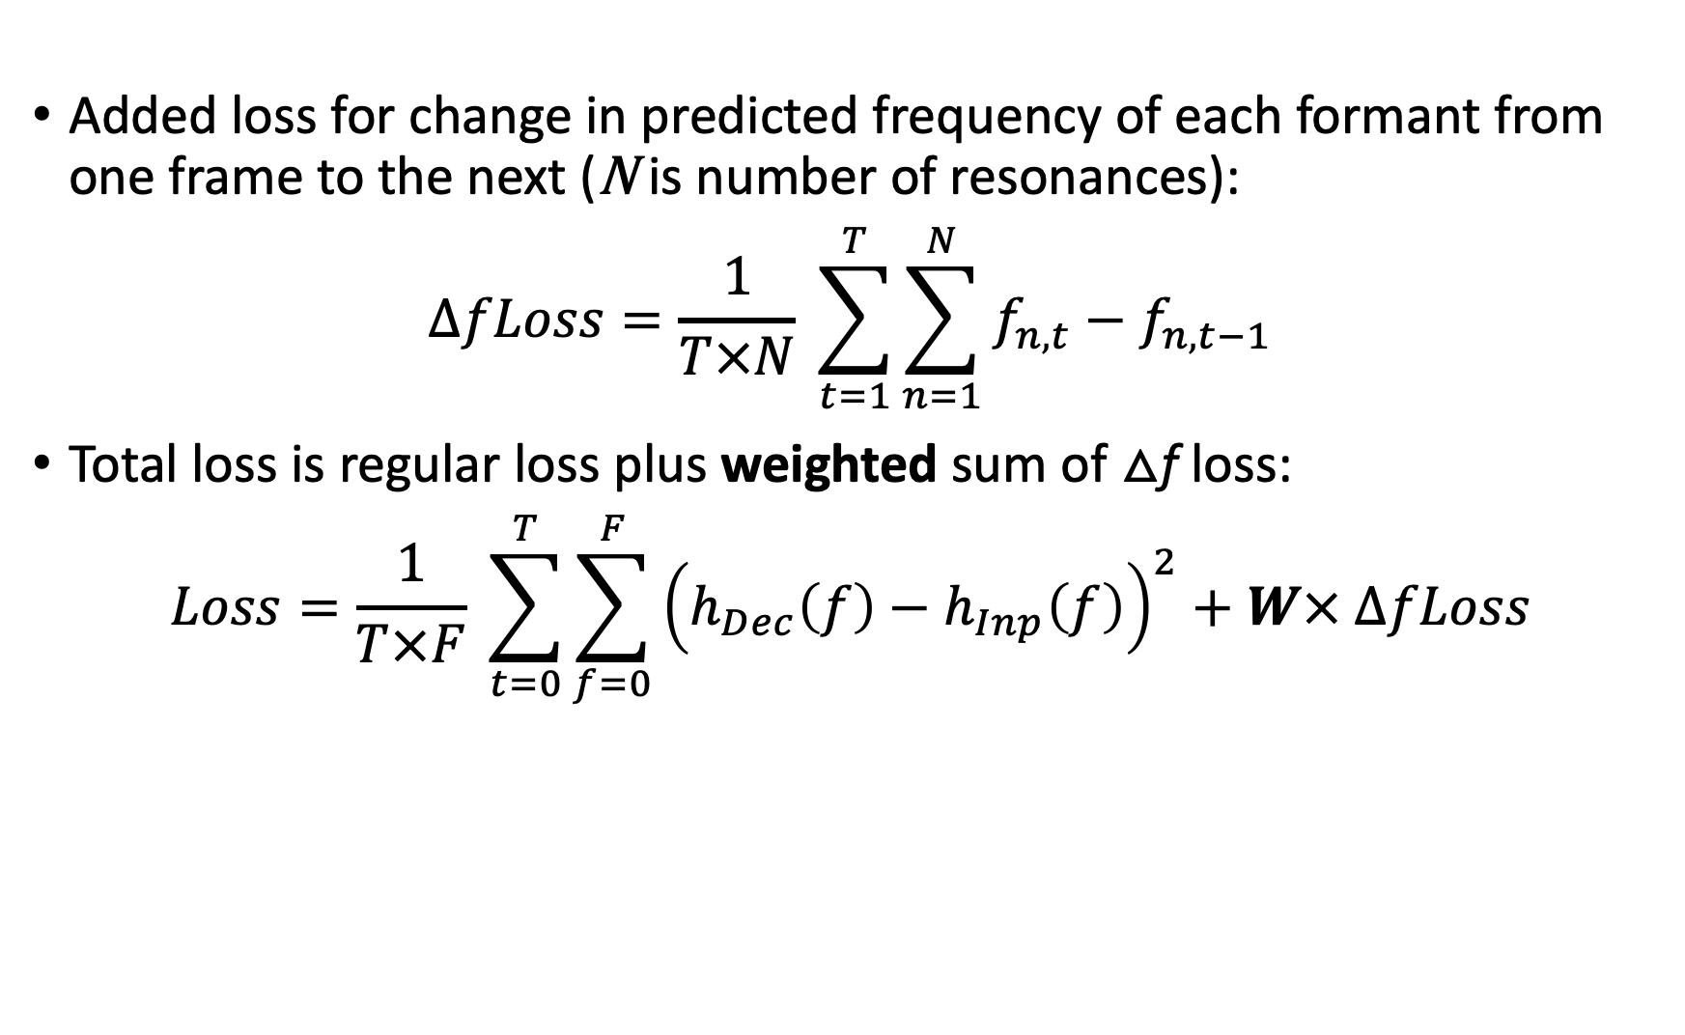
Delta-frequency (△f) Loss
Added loss for change in predicted frequency of each formant from one frame to the next (N is number of resonances):
$$ΔfLoss=\frac{1}{T×N} \sum_{t=1}^{T}{\sum_{n=1}^{N}{f_{n,t}−f_{n,t−1}}}$$
Total loss is regular loss plus weighted sum of △f loss:
$$Loss=\frac{1}{T×F} \sum_{t=0}^{T}{\sum_{f=0}^{F}{{\left(h_{Dec}\left(f\right)−h_{Inp}\left(f\right)\right)}^{2}}}+W× ΔfLoss$$

Slide 38
△f Loss: Effect of weight W
MAE, all segments
W | Mean | F1 | F2 | F3
0 | 114 | 100 | 115 | 126
0.01 | 111 | 102 | 107 | 123
0.05 | 105 | 97 | 99 | 118
0.10 | 114 | 91 | 103 | 149
0.15 | 152 | 97 | 157 | 204
0.20 | 321 | 114 | 218 | 631
0.25 | 192 | 112 | 223 | 242
MAE, vowels
W | Mean | F1 | F2 | F3
0 | 76 | 64 | 75 | 90
0.01 | 75 | 65 | 74 | 87
0.05 | 75 | 62 | 72 | 92
0.10 | 88 | 58 | 74 | 133
0.15 | 132 | 60 | 134 | 202
0.20 | 295 | 77 | 182 | 624
0.25 | 177 | 77 | 205 | 250

Slide 39
△f loss (Pre-emphasis model)
MAE, all segments
w | Mean | F1 | F2 | F3
0 | 118 | 92 | 123 | 140
.05 | 99 | 91 | 99 | 108
.10 | 98 | 90 | 97 | 108
.15 | 98 | 88 | 98 | 109
.20 | 105 | 90 | 98 | 128
.25 | 121 | 92 | 109 | 164
MAE, vowels
w | Mean | F1 | F2 | F3
0 | 76 | 61 | 76 | 92
.05 | 72 | 62 | 71 | 84
.10 | 71 | 60 | 70 | 84
.15 | 71 | 58 | 70 | 86
.20 | 78 | 58 | 70 | 106
.25 | 98 | 59 | 83 | 151

Slide 40
△f loss (No source model)
MAE, all segments
w | Mean | F1 | F2 | F3
0 | 115 | 94 | 121 | 130
.05 | 102 | 93 | 105 | 109
.10 | 99 | 89 | 98 | 111
.15 | 113 | 89 | 102 | 149
.20 | 123 | 89 | 105 | 176
.25 | 131 | 89 | 112 | 193
MAE, vowels
w | Mean | F1 | F2 | F3
0 | 76 | 52 | 80 | 94
.05 | 71 | 51 | 76 | 85
.10 | 70 | 51 | 72 | 87
.15 | 87 | 51 | 78 | 133
.20 | 99 | 51 | 81 | 166
.25 | 109 | 51 | 89 | 186

Slide 41
Source Modeling (no △f Loss)
MAE, all segments
Source | Mean | F1 | F2 | F3
IAIF | 113 | 101 | 114 | 126
Pre-emphasis | 115 | 94 | 121 | 130
None | 118 | 92 | 123 | 140
MAE, vowels
Source | Mean | F1 | F2 | F3
IAIF | 77 | 65 | 75 | 90
Pre-emphasis | 76 | 52 | 80 | 94
None | 76 | 61 | 76 | 92

Slide 42
Source Modeling (w=5)
MAE, all segments
Model | Mean | F1 | F2 | F3
IAIF | 105 | 97 | 99 | 118
Pre-emphasis | 102 | 93 | 105 | 109
None | 99 | 91 | 99 | 108
MAE, vowels
Model | Mean | F1 | F2 | F3
IAIF | 75 | 62 | 72 | 92
Pre-emphasis | 71 | 51 | 76 | 85
None | 72 | 62 | 71 | 84

Slide 43
Source Modeling (w=10)
MAE, all segments
Model | Mean | F1 | F2 | F3
IAIF | 105 | 90 | 100 | 123
Pre-emphasis | 99 | 89 | 98 | 111
None | 98 | 90 | 97 | 108
MAE, vowels
Model | Mean | F1 | F2 | F3
IAIF | 77 | 57 | 71 | 101
Pre-emphasis | 70 | 51 | 72 | 87
None | 71 | 60 | 70 | 84

Slide 44
Source Modeling (w=15)
MAE, all segments
Model | Mean | F1 | F2 | F3
IAIF | 152 | 97 | 157 | 204
Pre-emphasis | 113 | 89 | 102 | 149
None | 98 | 88 | 98 | 109
MAE, vowels
Model | Mean | F1 | F2 | F3
IAIF | 132 | 60 | 134 | 202
Pre-emphasis | 87 | 51 | 78 | 133
None | 71 | 58 | 70 | 86

Slide 45
Source Modeling w/△f Loss (“best” weights)
MAE, all segments
Source | W | Mean | F1 | F2 | F3
IAIF | .05 | 105 | 97 | 99 | 118
Pre-emphasis | .15 | 98 | 88 | 98 | 109
None | .10 | 99 | 89 | 98 | 111
MAE, vowels
Source | W | Mean | F1 | F2 | F3
IAIF | .05 | 75 | 62 | 72 | 92
Pre-emphasis | .15 | 71 | 58 | 70 | 86
None | .10 | 70 | 51 | 72 | 87

Slide 46
Deep Neural Networks (DNNs)
Consist of layers of units (circles)
Units compute a nonlinear function of the weighted sum of its inputs: y = f(WX + B)
Outputs are compared to target reference values to compute a loss (error)
Loss is used to adjust model weights in a process called backpropagation (red arrows)
Special types of neural networks:
Convolutional neural network (CNN): Used for image input (e.g. spectrograms)
Recurrent neural network (RNN): Used for sequences (e.g. sound waves)
LSTM (Long Short-Term Memory): one type of RNN
Reference
Values

Slide 47
Reference
Values

